Slide 1
SYSTEMIC(s), ARTIFICIAL INTELLIGENCE (AI) AND BUSINESS INTELLIGENCE (BI): Issues, challenges and opportunities
PLENARY PAPER
Professor Peter P. Groumpos
Department of Electrical
and Computer Engineering
University of Patras, Greece. groumpos@ece.upatras.gr

Slide 2
The Hellenic Society for Systemic Studies (HSSS) 15th HSSS National & International Conference Systemics and Business Intelligence Department of Informatics University of Piraeus 29-30 November 2019

Slide 3
Presentation Overview
Introduction
Systemic(s)
Intelligence
Artificial Intelligence (AI)
Business Intelligence (BI)
Today’s Business environments
Seeking True Knowledge
The future of AI and BI
Babylon or Athens and Plato or Aristotle
Future Research
Conclusions

Slide 4
INTRODUCTION (1/3)
The business environment today is changing fast and becoming more and more complex.
Organizations are required to make frequent strategic, tactical and organizational decisions. Some of which are very complex.
Making such decisions may require considerable data, information and knowledge.
Processing these, must be done quickly, frequently in real-time and suing computerized support.
Different new scientific methods are used
AI and Business Intelligent (BI) are such two new methods as computerized support for managerial decision making.

Slide 5
INTRODUCTION (2/3)
AI is the study of how to make computers do things at which, at the moment, people are better. Or AI is the simulation of human intelligence processes by machines, especially computer systems.
BI is a technology-driven process for analyzing data and presenting actionable information “intelligently” which helps executives, managers and other corporate end users make informed business decisions that maximize their chance of successfully achieving their goals.

Slide 6
INTRODUCTION (3/3)
NOW THE QUESTION IS IF AND HOW
AI CAN BE USEFULL TO BI?
CAN ALSO SYSTEMIC BE
OF HELP ON THIS EFFORT?
ABSOLUTELY YES

Slide 7
SYSTEMIC(s)!! (1/2)
Systemic refers to something that is spread throughout, system-wide, affecting a group or system, such as a body, economy, market or society as a whole.
Looks at circular or reciprocal influence rather than linear influence.
Systemic (or Systematic?) thinking has been influenced by natural science, mathematics, chaos theory, physics, systems theory, psychoanalysis, anthropology and evolutionary psychology.
Circular causality: Looks at the way conflict occurs in the context of others who are causing reciprocal grief.

Slide 8
SYSTEMIC(s)!! (2/2)
Creativity is essential, but in many cases not sufficient to explore the many possible candidate solutions.
A more systematic and methodical approach can help to overcome many of the problems that arise during conceptualizing in design Decision Making Support Systems (DMSS).
Use of appropriate methods to enhance the search for solutions can expand the solution field.
A systematic approach based on interdisciplinary science has been shown to enhance understanding, good record-keeping, and traceability for the business process.
Several systemic theories when are brought into mutual context, they refer to memory and thinking operations, expertise, human action modes, and competencies.

Slide 9
MANAGEMENT AND BUSINESS
“It is the theory that decides what we can observe.”
Albert Einstein
Management” as a science, emerged late in the 19th
century, gained respect and peaked in academic world to the end of 20th century.
Now, it is a fundamental school of concept for all kind of works no matter of its orientation either as business or engineering.

Slide 10
KNOWLEDGE (1/2)
What is Knowledge? How is it generated?
How do we handle the huge amount of data?
What is the process of learning?
What is a Complex Dynamic System (CDS)?
What are its main characteristics?

Slide 11
KNOWLEDGE (2/2)
What are the best models for business?
Do all models have detailed software tools that can adequately simulate their behavior?
What is intelligence?
What is wisdom?
Is “History” Important?

Slide 12
HISTORY IS IMPORTANT
History is both a guide to future activity in any scientific field and a record of the ideas and actions of those who have helped advance our thinking and practices through the ages.
In a technology field as diverse as Knowledge, Learning and Decision Making Support Systems (DMSS),
history is neither neat nor linear.

Slide 13
About Intelligence (1/3)
A VERY BASIC QUESTION: what is intelligence?
Intelligence is the ability to carry out abstract thinking.
Intelligence is an inferred process that humans use to explain the different degrees of adaptive success in people’s behavior
Intelligence is the ability to learn from experience, solve problems, and use our knowledge to adapt to new situations.
Learning, manipulating with facts, but also creativity, consciousness, emotion and intuition
How about knowing when you’re wrong?
Intelligence is adaptation to the environment.
Intelligence is what you do when you don't know what to do.

Slide 14
What is Intelligence? (2/3)
The mental abilities that enable one to adapt to, shape, or select one’s environment
The ability to judge, comprehend, and reason
The ability to understand and deal with people, objects, and symbols
The ability to act purposefully, think rationally, and deal effectively with the environment

Slide 15
About Intelligence (3/3)
Intelligence is subjective,
You need not be great in all domains to be called intelligent.
Physicists boil watches!
An athlete runs very fast!
Intelligence is a relative measure.
A very small child who talks easily
A dog which identifies his owner’s voice
A manager is very effective

Slide 16
Intelligence: Ability or Abilities?
Have you ever thought that since people’s mental abilities are so diverse, it may not be justifiable to label those abilities with only one word, intelligence?
You may speculate that diverse abilities represent different kinds of intelligences. How can you test this idea?
16
Notes:
16

Slide 17
INTELLIGENCE and AI
Can machines be intelligent?
Up to the present day it is not sure whether it is possible to build a machine that has all aspects of intelligence.
This kind of research is central in the field of AI.

Slide 18
WHAT IS ARTIFICIAL INTELLIGENCE?
Artificial Intelligence (AI) is intelligence displayed by machines, in contrast with the natural intelligence displayed by humans and other animals.
Our Attempt to Build Models of Ourselves
Is the study of how to make computers do things at which, at the moment, people are better.
Or, Stepping Back Even Farther,
Can We Build Artificial People?

Slide 19
Artificial Intelligence (AI)?
Examples
GENERIC
Computer science
Engineering and Robotics
Education
Health
Energy and Environment
Business and Finance
Toys and games
SPECIFICS
Thermostats?
Computers that switch to “stand by” mode automatically?
Phones that recognize names?
Managing all activities in a hotel automatically?
Banking transactions without human interventions
Diagnostic capabilities on a remote medical center
Detecting poisoned food
Airplane seat selection

Slide 20
What are the goals of Artificial Intelligence?
To create machines, that can do more jobs than previous ones, with better performance.
To add features to machines which machines don’t have, but human has.
Human can conclude from known facts.
Human can guess!
Human can make relations between new un-identified objects and known objects.

Slide 21
Why are Humans Intelligent?
Learning
Reasoning
Problem Solving
Making decisions
Feeling environment
Vision (being able to recognize object by seeing)
Audio (being able to recognize voices)

Slide 22
A more Formal Definition of ARTIFICIAL INTELLIGENCE
 | Human Level logic + emotion | Logical
Behavior | Systems that behave like humans. | Systems that act logically.
Thinking | Systems that think like humans. | Systems that think logically.

Slide 23
When Philosophy interacts with AI….
CAN MACHINES THINK?
Can: now or future? Maybe we need more advanced technology
Machine: Is human a protein machine?
Think: Does the intelligent system “knows” what it does?
Engineering view: It’s not important! Machines can help us in industry…and that’s enough!

Slide 24
HISTORICAL OVERVIEW
THIS IS A VERY OPEN ISSUE. THE READER COULD PERFORM HIS/HER OWN OVERVIEW. HOWEVER HERE IS A START
Ancient and medieval myths
Talos, Pandora, Golem
artificial men, robots, automatons
Research in the antiquity till the 17th century
Aristotle, Gottfried Wilhelm Leibniz
automation of reasoning
Thomas Hobbes, René Descartes
mechanistic understanding of living beings
20th century, 1948
Norbert Wiener – Cybernetics: Or the Control and Communication in the Animal and the Machine.
Intelligent behavior is the result of the feedback mechanism

Slide 25
AI METHODS AND ARCHITECTURES
There are various AI Methods
and Architectures such as:
artificial neural networks (ANN)
deep neural networks
convolutional deep neural networks,
Belief Neural Networks
Recurrent Neural Networks (RNN)
Gabor filters and support vector machines(SVMs)
mixture model/Hidden Markov model (GMM-HMM)
long short term memory (LSTM)

Slide 26
SOME GENERIC APPROACHES
Deep Learning
Intelligent Learning and Intelligent Systems
Cognitive Learning
Wise learning and Wise decision making
Internet of things
Big Data Driven World
Cyber Physical Systems
Industry 4.0
Systems of Systems
Neurosciences
Fuzzy Cognition and Fuzzy systems

Slide 27
Drawbacks of Deep Learning (AI)(1/2)
Need infinite data/ Never enough the given data
Very slow to train
Availability of algorithms – lots of Python implementations, pretty rate in other languages (e.g. R)
Models are very complex, with lot of parameters to optimize:
Initialization of weights
Layer-wise training algorithm (RBM, AE, several others)
Neural architecture
Number of layers
Size of layers
Type – regular, pooling, max pooling, soft max
Fine-tuning using back prop or feed outputs into a different classifier

Slide 28
Drawbacks of Deep Learning (AI) (2/2)
Steep learning curve
Some problems more amenable to deep learning than other applications
Simpler models may be sufficient for certain problem domains
Regression models? How reliable can be!!

Slide 29
TODAYS’ BUSINESS ENVIRONMENT
Business environments changed dramatically
Nowadays managers use computerized support in making decisions.
DSS is quickly becoming a shared commodity across the organization, utilizing the networks (Internet and Intranet).
Data are stored in multiple locations. Using distributed systems, intranet, extranet and Internet, corporations can easily access those data, analyzing it and report it to decision makers.

Slide 30
TODAY A MUST IS TO: (1/2)
Understand today’s turbulent business environment and describe how organizations survive and even excel in such an environment
Understand the need for computerized support of managerial decision making
Understand an early framework for managerial decision making
Learn the conceptual foundations of the decision support systems (DSS) methodology

Slide 31
TODAY A MUST IS TO: (2/2)
Describe the business intelligence (BI) methodology and concepts and relate them to DSS
Describe the concept of work systems and its relationship to decision support
List the major tools of computerized decision support
Understand the major issues in implementing computerized support systems

Slide 32
AND HOW?
AI
AND BI

Slide 33
BUSINESS INTELLIGENCE (BI)
Business intelligence (BI) is a technology-driven process for analyzing data and presenting actionable information which helps executives, managers and other corporate end users make informed business decisions.
“The processes, technologies and tools needed to turn data into information and information into knowledge and knowledge into plans that drive profitable business action. BI encompasses data warehousing, business analytics and knowledge management”

Slide 34
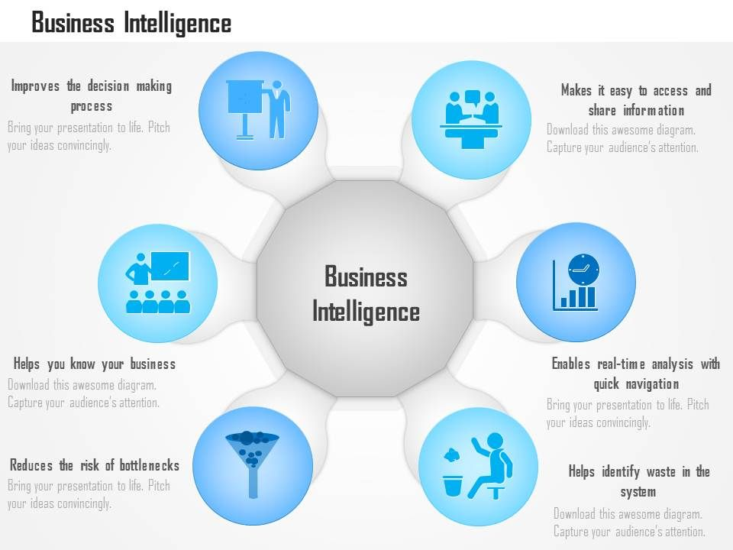

Slide 35
The Users of Business Intelligence
Executives and business decision makers look at the business from a high level, performing limited analysis
Analysts perform complex, detailed data analysis
Information workers need static reports or limited analytic power
Line workers need no analytic capabilities as BI is presented to them as part of their job
Notes:
The users of BI can be broken down into:
High-level users with the need for a broad view and limited analytics capabilities
Those specialized users who perform detailed data analysis and need powerful tools
Workers who need basic reports with possible analytic features
Workers who have BI built into the systems they use without realizing it is BI

Slide 36
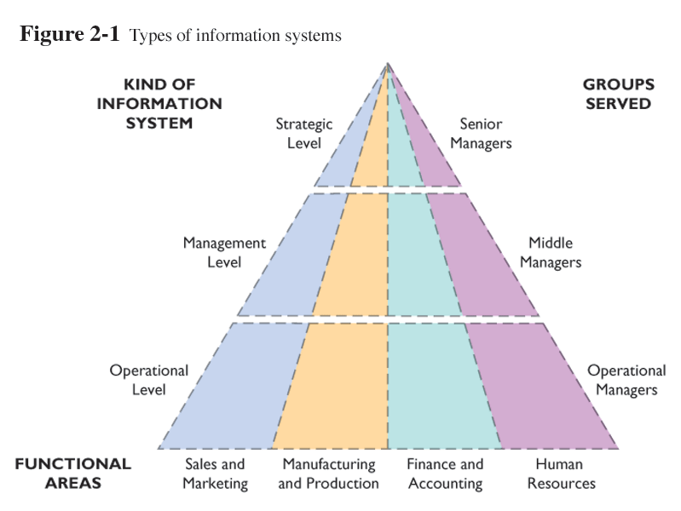
The Users of Business Intelligence
Notes:
The users of BI can be broken down into:
High-level users with the need for a broad view and limited analytics capabilities
Those specialized users who perform detailed data analysis and need powerful tools
Workers who need basic reports with possible analytic features
Workers who have BI built into the systems they use without realizing it is BI

Slide 37
AI AND BI (1/2)
Various ITs and AI methods are being integrated with each other and/or with other automated systems. This integration results more accurate information, which enables managers to make better decisions.
The friendly and easy to use DSS interface allows users to view and process data and models with standard web browsers with flexibility and efficiency.
Managers can communicate with computer and the web using wireless and/or wired devices (cell phones, PADs)

Slide 38
AI AND BI (2/2)
Data warehouse and their analytical tools (such as OLAP: On-Line Analytical Processing) enhance information access across organizational boundaries.
Artificial Intelligence methods are improving the quality of decision making support and are becoming embedded in many applications (web search engines).
Developments in organizational learning and knowledge management deliver the entire organization’s expertise to bear on problems anytime and anywhere.

Slide 39
Opening Vignette: Toyota using Business Intelligent to Excel
Keeping Vehicle in transit is money costing.
144 to 160 million US$ / year
Problems in supply chain, deliver cars to dealers made customers to buy cars from competitors (Honda).
Data exists, but managers can not use this data strategically. No shared data, reports were always late.
Managers were unable to make timely decisions.
IT in organization was unable to respond to the growing business.

Slide 40
Changing Business Environments and Computerized Decision Support
To realize why Toyota embraces computerized support, including business intelligence a “business pressures-responses-support model” has been developed. See Figure 1.1 next slide.
The model components are:
The business environment (becomes complex)
Organizational responses: be reactive, anticipative, adaptive, and proactive, so as to take advantage of opportunities available
Computerized support that facilitates monitoring and enhance response

Slide 41
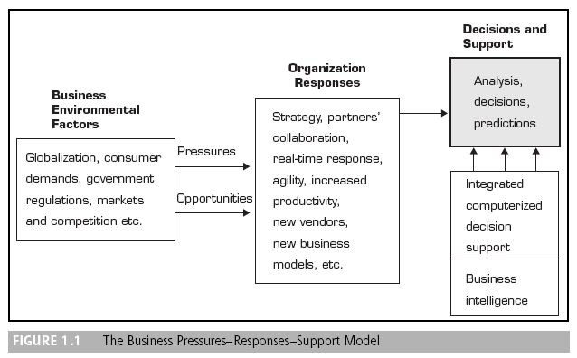
Managerial Decision Making

Slide 42
Changing Business Environments and Computerized Decision Support
The business Environment:
Today's environment complexity creates
opportunity on one hand and
problems on the other hand for organizations.
Example: Globalization (Internet)
One can easily find suppliers and costumers in many countries, which means buying cheaper materials and sell more products and services.
More and stronger competitors.

Slide 43
Changing Business Environments and Computerized Decision Support
The intensity of the business environment factors (Markets, customer demands, Technology and societal) increases with time, leading to more pressure and competition.
Q) How managers will respond quickly, innovative and agilely under the above environment?
By using computerized support. Take for example Toyota (opening vignette) TSL . They turned to BI to improve communication and to support executives in their effort to know exactly what is going on in each area of operation (real-time)
Doing so, organization can cut expenses and increase customer satisfaction.
Q) What is the major objective of the computerized DS?
It is to facilitate closing the gap between the current performance of an organization and its desired performance.

Slide 44
SEEKING TRUE KNOWLEDGE (1/3)
Raphael, detail of Plato and Aristotle, School of Athens, 1509-1511, fresco (Stanza della Segnatura, Palazzi Pontifici, Vatican)

Slide 45
SEEKING TRUE KNOWLEDGE (2/3)
Aristotle gestures to the earth, while holding a copy of his Nicomachean Ethics in his hand.
Plato gestures to the heavens, representing his belief in The Forms, while holding a copy of Timaeus.
Plato's hand is pointing to the sky, the World of Ideas, which was primary for him, while Aristotle motions ground, the material world, into which he grounded the existence.

Slide 46
SEEKING TRUE KNOWLEDGE (3/3)
While the ontological views of Plato and Aristotle differ a lot, the epistemological views are quite similar.
Both of them see the source of knowledge in ideas or forms.
However, they propose different methods to acquire knowledge: for Plato knowledge is purely rational, while Aristotle appreciates also empirical knowledge.

Slide 47
THE FUTURE OF AI AND BI
I PROVIDE SOME PERSONAL VIEWS
HOPING TO PROVOKE A USEFUL DISCUSSION

Slide 48
SOME IMPORTANT HISTORICAL REMARKS
Historians of Homo sapiens such as Yuval Noah Harari (an Israel Historian Professor) and Steven Mithen ( a British professor of Archaeology) are in general agreement that the decisive ingredient that gave our ancestors the ability to achieve global dominion about forty thousand years ago was their ability to create and store a mental representation of their environment, interrogate that representation, distort it by mental acts of imagination, and finally answer the “What if?” kind of questions.
Examples are interventional questions (“What if I do such-and-such?”) and retrospective or counterfactual questions (“What if I had acted differently?”).
No learning machine in operation today can answer such questions.
Moreover, most learning machines do not possess a representation from which the answers to such questions can be derived.

Slide 49
BABYLON OR ATHENS? (1/6)
With regard to causal reasoning, I personally believe that you can do very little with any form of model-blind curve fitting, or any statistical inference, no matter how sophisticated the fitting process is. We can also always find a theoretical framework for organizing such limitations, which forms a hierarchy.
MY QUESTION REMAINS: IS THIS ENOUGH??!! LET US SEE
On the first level, you have statistical reasoning, which can tell you only how seeing one event would change your belief about another. For example, what can a symptom tell you about a disease?
Then you have a second level, which entails the first but not vice versa.
It deals with actions. “What will happen if we raise prices?” “What if you make me laugh?” That second level of the hierarchy requires information about interventions which is not available in the first.
This information can be encoded in a graphical model, which merely tells us which variable responds to another.

Slide 50
BABYLON OR ATHENS?(2/6)
The third level of the hierarchy is the counterfactual. This is the language used by scientists. “What if the object were twice as heavy?” “What if I were to do things differently?” “Was it the aspirin that cured my headache, or the nap I took?” Counterfactuals are at the top level in the sense that they cannot be derived even if we could predict the effects of all actions. They need an extra ingredient, in the form of equations, to tell us how variables respond to changes in other variables.

Slide 51
BABYLON OR ATHENS? (3/6)
I believe that a great achievement of the causal-inference research has been the mathematical formulation of both interventions and counterfactuals as the top two layers of the hierarchy.
In other words, once we mathematically encode our “scientific knowledge” in a model, algorithms either exist or can be developed that examine the model and determine if a given query, be it about an intervention or about a counterfactual, can be estimated from the available data—and, if so, how.(always mathematically)
This mathematical development has transformed dramatically the way scientists are performing research, especially in such data-intensive sciences as business, medicine, geology, biology, economics, psychology, space and sociology, for which causal models have become a second language.

Slide 52
BABYLON OR ATHENS? (4/6)
However are we aware of the basic limitations that were discovered in the causal-inference arena? Are we prepared to circumvent the theoretical impediments that prevent us from going from one level of the hierarchy to another level? Are the AI and Deep Learning drawbacks reasons of preventing this?
Machine learning as a tool is to get us from data to probabilities.
But then we still have to make two extra steps to go from probabilities into real understandings (the causal-inference arena)
AND THERE ARE TWO BIG STEPS!!!
One is to predict the effect of actions, and the second is counterfactual imagination.
We cannot claim to understand reality unless we make these last two steps.

Slide 53
BABYLON OR ATHENS? (5/6)
In his insightful book Foresight and Understanding (1961), the philosopher Stephen Toulmin identified the transparency-versus-opacity contrast as the key to understanding the ancient rivalry between Greek and Babylonian sciences.
According to Toulmin, the Babylonian astronomers were masters of black-box predictions, far surpassing their Greek rivals in accuracy and consistency of celestial observations.
Yet Science favored the creative-speculative strategy of the Greek astronomers, which was wild with metaphorical imagery: circular tubes full of fire, small holes through which celestial fire was visible as stars, and hemispherical Earth riding on turtleback.
It was this wild modeling strategy, not Babylonian extrapolation, that jolted Eratosthenes (276-194 BC) to perform one of the most creative experiments in the ancient world and calculate the circumference of the Earth. Such an experiment would never have occurred to a Babylonian data-fitter.

Slide 54
BABYLON OR ATHENS? (6/6)
Model-blind approaches impose intrinsic limitations on the cognitive tasks that strong AI can perform. My general conclusion is that human-level AI cannot emerge solely from model-blind learning machines; it requires the symbiotic collaboration of data and models.
BIG Data science is a science only to the extent that it facilitates the interpretation of data—a two-body problem, connecting data to reality.
Data alone are hardly a science, no matter how “big” they get and how skillfully they are manipulated.
Big Data and Opaque learning systems may get us:
To Babylon, but not to Athens.
But the world today needs more Athens than Babylon approaches

Slide 55
SEEKING TRUE KNOWLEDGE
Raphael, detail of Plato and Aristotle, School of Athens, 1509-1511, fresco (Stanza della Segnatura, Palazzi Pontifici, Vatican)

Slide 56
HOW CAN WE PROCEED?
THERE IS ONLY ONE WAY
TO SET AND KEEP AS OUR MAIN SYSTEMIC WAY A STRONG WILL TO GO AND REMAIN TO ATHENS
By:
LEARNING BETTER THE CAUSAL-INFERENCE AREANA
One approach to help this is the new theories of Fuzzy Cognitive Maps (FCM)

Slide 57
Modelling complex Systems Using Fuzzy Cognitive Maps (FCMs)
Modeling a system as a collection of concepts and causal links between them.
Nodes: Represent the system’s concepts. Concepts correspond to the characteristics of the system. They are states inputs, outputs, constraints, variables ….
Arrows: Interconnection between nodes. Show the cause-effect relationship between them.

Slide 58
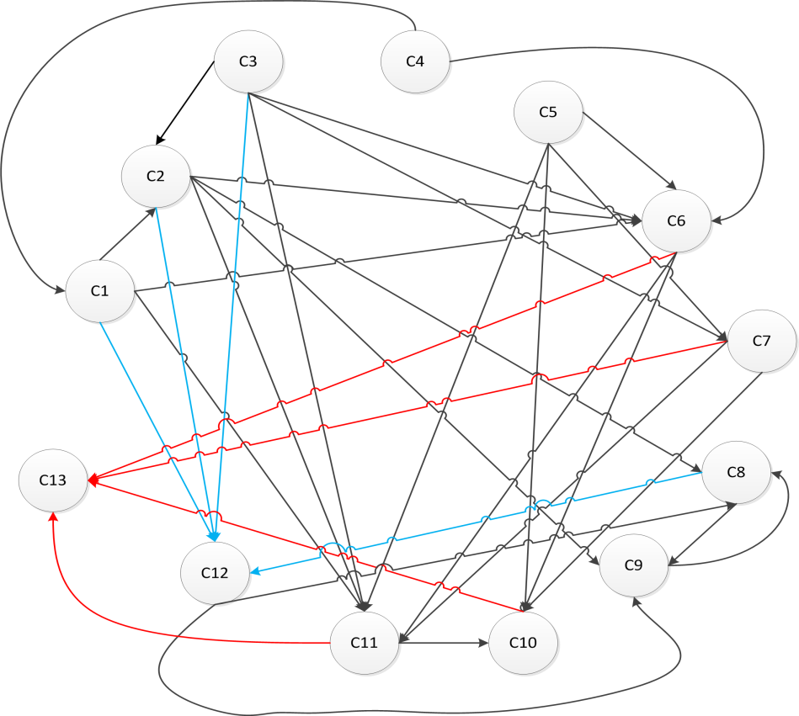
Fuzzy Cognitive Maps (1/3)
Between concepts, there are three possible types of causal relationships that express the type of influence from one concept to another:
W_{ij} > 0 (C_{i} ↑ ⇒ C_{j} ↑)
W_{ij} < 0 (C_{i} ↑ ⇒ C_{j} ↓)
W_{ij} = 0 (C_{i} , C_{j} ⇒ not correlated)
Attention: Causality vs. Correlation

Slide 59
Fuzzy Cognitive Maps (2/3)
The FCM concepts take initial values. These values change, depending on the interaction, until they reach an equilibrium
The value of each concept is calculated applying the following calculation rule at each simulation step :
Where f is the sigmoid function (λ>0 steepness of the function)
The iterations stop when a stable state is achieved

Slide 60
Fuzzy Cognitive Maps (3/3)
Training methods for the weights (W_{ij}):
Active Hebbian Learning algorithm
Nonlinear Hebbian Learning algorithm
Evolutionary algorithms
Experts exclusion algorithm
Basic concept of the abovementioned methods is the minimization of specific criteria functions in order to control the desired output region of the system.

Slide 61
FCMs – Why are they useful?
A simple presentation of a complex system.
Close to human reasoning.
Avoiding complex mathematical equations and calculations.
Use of experts’ knowledge and experience (the created model is closer to the real system).
They can be combined with learning algorithms improving the model response.
Implementation on various system models (social, economical, web-mining, medical, energy and many others).

Slide 62
Example 1: Decision Making in Stability of an Enterprise in a crisis period using FCMs
The factor concepts in this model are:
C1: sales,
C2: turnover,
C3: expenditures,
C4: debts & loans,
C5: research & innovation,
C6: investments,
C7: market share,
C8: stability of enterprise and
C9: present capital of the enterprise

Slide 63
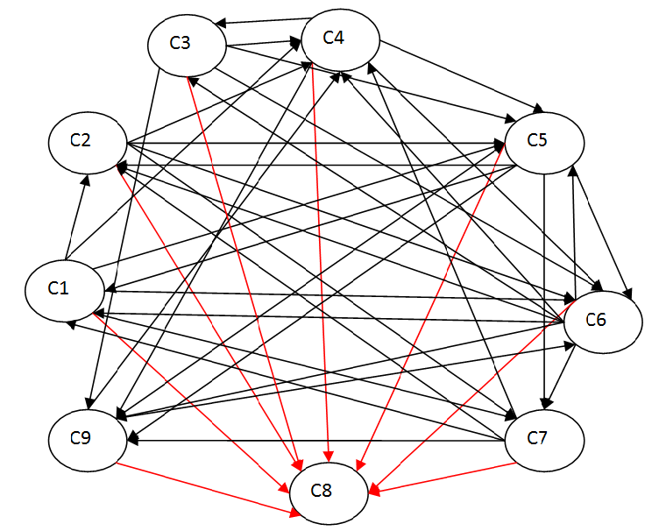
The proposed FCM MODEL

Slide 64
The corresponding table of Weights between concepts for Enterprise System weights
 | C1 | C2 | C3 | C4 | C5 | C6 | C7 | C8 | C9
C1 | 0 | 0.6 | 0 | -0.4 | 0.2 | 0.3 | 0.6 | 0.8 | 0
C2 | 0 | 0 | 0 | -0.2 | 0.2 | 0.5 | 0.1 | 0.3 | 0
C3 | 0 | 0 | 0 | 0.4 | -0.5 | -0.4 | 0 | -0.6 | -0.5
C4 | 0 | 0 | -0.4 | 0 | -0.7 | -0.8 | 0 | -0.7 | -0.4
C5 | 0.2 | 0.3 | 0 | 0 | 0 | 0.5 | 0.3 | 0.2 | -0.2
C6 | 0.3 | 0.2 | 0.6 | 0.5 | -0.3 | 0 | 0.3 | 0.3 | -0.4
C7 | 0.4 | 0.3 | 0 | -0.2 | 0 | 0 | 0 | 0.4 | 0.5
C8 | 0 | 0 | 0 | 0 | 0 | 0 | 0 | 0 | 0
C9 | 0 | 0 | 0 | -0.3 | 0.2 | 0.4 | 0 | 0.2 | 0

Slide 65
Assumptions been made by experts and simulation results
Initial conditions
$$A^{(0)}=\left[0.8867 0.4667 0.0967 0.0967 0.4667 0.0967 0.0967 0.65 0.4667\right]$$
Final values after conversion after iterations
$A^{(11)}=[0.8140 0.8708 0.7145 0.6121 0.4743 0.7462 0.8581 0.8391 0.4779]$
Since the concept 8 (the stability) has reached a value of 0.8391 the enterprise has a stable future

Slide 66
SIMULATION RESULTS

Slide 67
EXAMPLE 2: FDI AND FCM
Foreign Investment: One of the most important strategic decisions for a company
Economic globalization → the firms can access easily the foreign markets
The question is restated:
“The companies should invest to a country through Foreign Direct Investments (FDI) or approach their market through other market mechanisms (cooperation with independent domestic firms) ?”

Slide 68
A DSS FOR MARKET EVALUATION FOR FOREIGN INVESTMENT
We set out to develop a tool for decision support for a country’s market assessment, when examining a country as a potential market for investment
We assess the profitability of a country’s taking simultaneously into account all relative factors:
C1: Market Growth,
C2: Market Size,
C3: Concentration Ratio,
C4: Threat of New Entrants,
C5: Barriers of New Entrants,
C6: Bargaining Power of Suppliers,
C7: Bargaining Power of Customers/Buyers,
C8: Intensity of Competitive Rivalry,
C9: Threat of Substitute Products or Services,
C10: Sector’s Competitiveness,
C11: Country’s Political stability,
C12: Country’s Demographic Situation,
C13: Technological Intensity,
C14: Taxation,
C15: Attractiveness and
C16: Profitability.

Slide 69
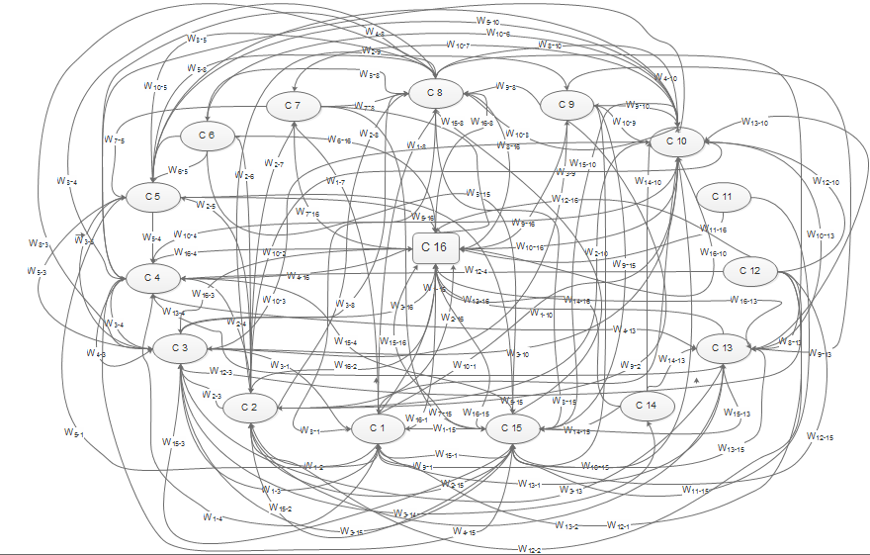
NUMERICAL VALUES OF THE CONCEPTS’ RELATIONSHIPS NHL FUZZY COGNITIVE MAP FOR FOREIGN INVESTMENT

Slide 70
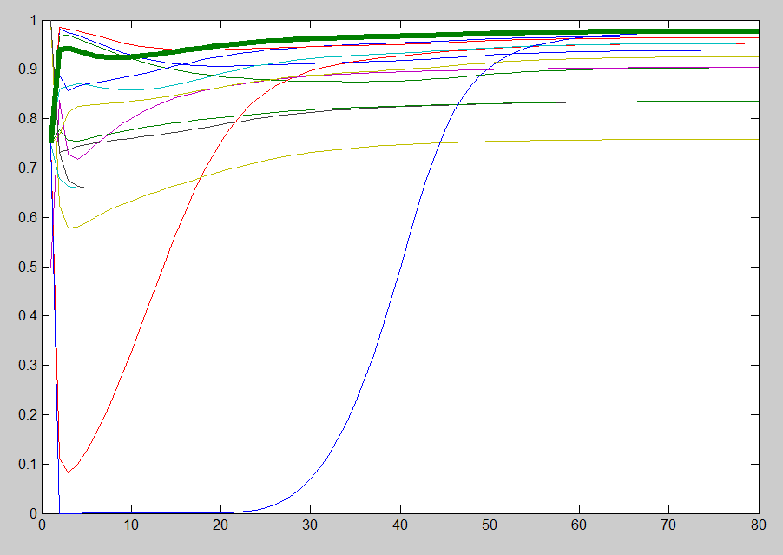
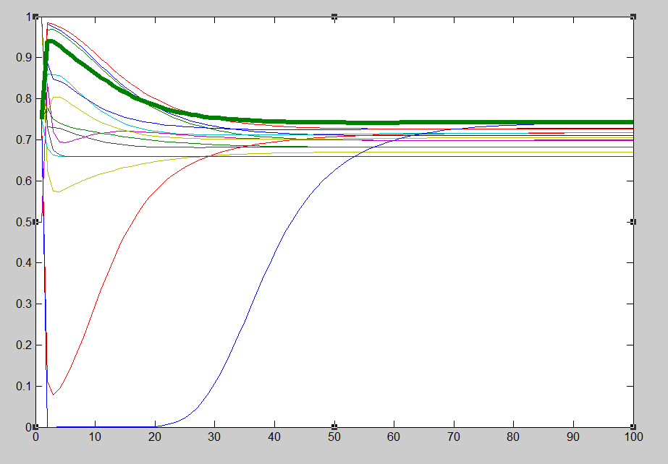
RESULTS
Implementation of the model to the business and consumer services’ industry of two separate case studies, concerning UK and Spain
Subsequent values of concepts till convergence for the case study of UK
Subsequent values of concepts till convergence for the case study of Spain

Slide 71
Another Example Making Wine
The following factors that significantly influence the quality of wine and the whole process of winery will be used as the main concepts that compose the nodes of the FCM:
C1: The special characteristics of the soil
C2: The climatic conditions in the region's vineyard
C3: The diversity of the vineyard and its features
C4: The Human Factor (cultivation tasks and farming cares in the vineyard)
C5: The Alcoholic Fermentation
C6: Diseases, alterations and deterioration of the quality of the wine
C7: Additional Oenological Substances to wine
C8: The Storage of wine in barrels
C9: The Maturation - Aging of wine
C10 (Output): Wine Quality

Slide 72
FUTURE RESEARCH
WIDE OPEN

Slide 73
CONCLUSIONS
The world is changing fast
It needs new scientific and technological approaches
AI a promising
Many Successes but also some failures
Certainly there are a number of real threats
Business and management systems change dramatically
BI also is a promising approach
Many challenges and opportunities
AI and BI cannot succeed disregarding human brain and Cognitive science

Slide 74
Conclusions (cont)
Fuzzy Cognitive Maps can be very useful for BI
Risks of developing super-intelligent machines
Moral / Ethical Issues
Morally sound AI And BI are a MUST

Slide 75
QUESTIONS??
THANK YOU FOR
YOUR ATTENTION
Professor Peter P. Groumpos
groumpos @ece.upatras.gr

